Slide 1

Vivek Raghuram
Telephone: (408) 207-3701
raghuram.vivek@gmail.com

Slide 2
330,000,000
97,900,000
Population of the United States
50%
Of smartphone users are 13-34
Use smartphones
Active internet users
Americans from ages 15-27
290,000,000
50,000,000
83%
165,000,000
Of 18-29 use social networks
Use social Networks

Slide 3
Web 1.0
Web 2.0
Two-way
network
desktop
mobile

Slide 4













two spaces
Desktop space
Mobile space
the
dimension
social
news
media
And many more

Slide 5










Desktop space
Mobile space

Slide 6
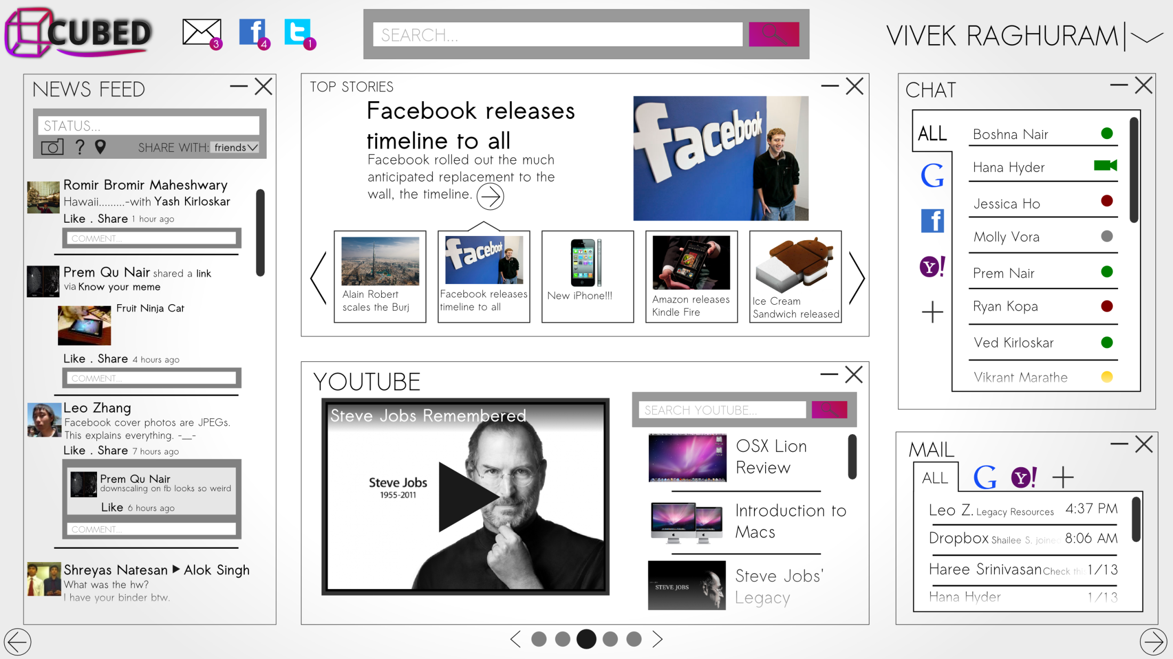

Slide 7
Content:
Revenue:
links
Rss feeds
Embedding
Hosting agreements
Community development
networks
Media
Themes
Widgets
News articles
Information streams
Display advertising
Revenue sharing deals
Community sales

Slide 8
STRENGTHS
Design
Versatility
Mobile
Social
Community
WEAKNESSES
Startup capital
Small
Limited resources
OPPURTUNITIES
Younger markets
Control web traffic
Media and communications
Platform
THREATS
Large portals
Media companies

Slide 9
Board of Advisors:
Carl Schmidt
Jeff Mueller
Bjorn Hartman
John Dunning
CEO Vivek Raghuram
CTO Prem Qu Nair
Website Development
CMO Ryan Kopa
Application Development
Marketing Team
CFO Aditya Kuroodi

Slide 10
Promotion:
6 month development period
3 month beta testing period
3 month Launch period
Growth phase

Slide 11
Other expenses include: Accounting, Equipment, Travel, Utilities, Insurance, and Misc.
Notes:
Minor includes cogs, accounting, equipment, travel, utilities, insurance, misc.

Slide 15
SECURED
REQUIRED
$750,000
Growth
$2,500,000
3 Month Launch Period
Exec. Team
Deals
3 Month Beta
Unique product concept
Hire EMployees
6 months of development
Facilities
Notes:
Minor includes cogs, accounting, equipment, travel, utilities, insurance, misc.

Slide 16


Slide 17
x40
return on investment
x15
x5
Notes:
Minor includes cogs, accounting, equipment, travel, utilities, insurance, misc.

Slide 18
financing
content
platforms
promotion
financial statements
questions?
revenue
expenses
target market
mockup
facilities
steps to startup
ROI
SWOT
Management team
iPad mockup
Notes:
Minor includes cogs, accounting, equipment, travel, utilities, insurance, misc.

Slide 19
Thank you for your time
Vivek Raghuram (CEO)
Email: raghuram.vivek@gmail.com
Phone: (408) 207-3701

Slide 20
Content:
links
Rss feeds
Embedding
Hosting agreements
Community development
networks
Media
Themes
Widgets
News articles
Information streams

Slide 21
Revenue:
Display advertising
Revenue sharing deals
Community sales

Slide 22





Slide 23
Projected Income Statement for the First Year
 | Month 1 | Month 2 | Month 3 | Month 4 | Month 5 | Month 6 | Month 7 | Month 8 | Month 9 | Month 10 | Month 11 | Month 12
Total Revenue | - | - | - | - | - | - | $0 | $0 | $0 | $14,421 | $27,982 | $43,985
Cost Of Goods Sold | - | - | - | - | - | - | $1,001 | $1,001 | $1,001 | $1,004 | $1,008 | $1,013
Gross Profit | - | - | - | - | - | - | ($1,001) | ($1,001) | ($1,001) | $13,416 | $26,974 | $42,972
Gross Margin % | - | - | - | - | - | - | n/a | n/a | n/a | 93% | 96% | 98%
Operating Expenses
Promotion | - | - | - | $1,000 | $1,000 | $1,000 | $20,000 | $20,000 | $20,000 | $120,000 | $120,000 | $120,000
Accounting and Legal | $1,000 | $1,000 | $1,000 | $1,000 | $1,000 | $1,000 | $1,000 | $1,000 | $1,000 | $1,000 | $1,000 | $1,000
Rent | $6,750 | $6,750 | $6,750 | $6,750 | $6,750 | $6,750 | $6,750 | $6,750 | $6,750 | $6,750 | $6,750 | $6,750
Equipment/Maintenance | $20,000 | $500 | $500 | $500 | $500 | $500 | $500 | $500 | $500 | $500 | $500 | $500
Travel | $1,000 | $1,000 | $1,000 | $1,000 | $1,000 | $1,000 | $1,000 | $1,000 | $1,000 | $1,000 | $1,000 | $1,000
Utilities | $250 | $250 | $250 | $250 | $250 | $250 | $250 | $250 | $250 | $250 | $250 | $250
Employees
-Management | $17,500 | $17,500 | $17,500 | $17,500 | $17,500 | $17,500 | $17,500 | $17,500 | $17,500 | $17,500 | $17,500 | $17,500
-Marketing | $18,750 | $18,750 | $18,750 | $18,750 | $18,750 | $18,750 | $18,750 | $18,750 | $18,750 | $18,750 | $18,750 | $18,750
- Engineers | $95,750 | $95,750 | $95,750 | $95,750 | $95,750 | $95,750 | $95,750 | $95,750 | $95,750 | $95,750 | $95,750 | $95,750
Insurance | $2,500 | $2,500 | $2,500 | $2,500 | $2,500 | $2,500 | $2,500 | $2,500 | $2,500 | $2,500 | $2,500 | $2,500
Miscellaneous | $300 | $300 | $300 | $300 | $300 | $300 | $300 | $300 | $300 | $300 | $300 | $300
Total Operating Expenses | $163,800 | $144,300 | $144,300 | $145,300 | $145,300 | $145,300 | $164,300 | $164,300 | $164,300 | $264,300 | $264,300 | $264,300
Operating Profit | ($163,800) | ($144,300) | ($144,300) | ($145,300) | ($145,300) | ($145,300) | ($165,301) | ($165,301) | ($165,301) | ($250,884) | ($237,326) | ($221,328)
Taxes | - | - | - | - | - | - | - | - | - | - | - | -
Net Profit | ($163,800) | ($144,300) | ($144,300) | ($145,300) | ($145,300) | ($145,300) | ($165,301) | ($165,301) | ($165,301) | ($250,884) | ($237,326) | ($221,328)

Slide 24
Projected Cash Flow for the First Year
 | Month 1 | Month 2 | Month 3 | Month 4 | Month 5 | Month 6 | Month 7 | Month 8 | Month 9 | Month 10 | Month 11 | Month 12
Beginning Cash | $0 | $3,086,200 | $2,941,900 | $2,797,600 | $2,652,300 | $2,507,000 | $2,361,700 | $2,196,400 | $2,031,099 | $1,865,798 | $1,614,914 | $1,377,588
Cash In
Founders Investment | $250,000 | - | - | - | - | - | - | - | - | - | - | -
Venture Capital Investment | $2,500,000 | - | - | - | - | - | - | - | - | - | - | -
Management Investment | $500,000 | - | - | - | - | - | - | - | - | - | - | -
Revenue | - | - | - | - | - | - | $0 | $0 | $0 | $14,421 | $27,982 | $43,985
Cash Out
Operating Expenses | $163,800 | $144,300 | $144,300 | $145,300 | $145,300 | $145,300 | $164,300 | $164,300 | $164,300 | $264,300 | $264,300 | $264,300
Bank Interest | - | - | - | - | - | - | - | - | - | - | - | -
COGS | - | - | - | - | - | - | $1,001 | $1,001 | $1,001 | $1,004 | $1,008 | $1,013
Taxes | - | - | - | - | - | - | - | - | - | - | - | -
Ending Cash | $3,086,200 | $2,941,900 | $2,797,600 | $2,652,300 | $2,507,000 | $2,361,700 | $2,196,400 | $2,031,099 | $1,865,798 | $1,614,914 | $1,377,588 | $1,156,259

Slide 25
Projected Income Statement for Three Years
 | Year 1 | Year 2 | Year 3
Total Revenue | $86,388 | $2,664,592 | $10,776,127
Cost Of Goods Sold | $6,029 | $12,129 | $12,004
Gross Profit | $80,359 | $2,652,463 | $10,764,124
Gross Margin % | 93.0% | 99.5% | 99.9%
Operating Expenses
Promotion | $423,000 | $1,200,000 | $1,680,000
Accounting and Legal | $12,000 | $12,000 | $12,000
Rent | $81,000 | $100,000 | $120,000
Equipment/Maintenance | $25,500 | $25,500 | $25,500
Travel | $12,000 | $12,000 | $12,000
Utilities | $3,000 | $3,000 | $3,000
Employees
-Management | $210,000 | $210,000 | $210,000
-Marketing | $225,000 | $500,000 | $1,200,000
- Engineers | $1,149,000 | $1,349,000 | $1,649,000
Insurance | $30,000 | $30,000 | $30,000
Miscellaneous | $3,600 | $3,600 | $3,600
Total Operating Expenses | $2,174,100 | $3,445,100 | $4,945,100
Operating Profit | ($2,093,741) | ($792,637) | $5,819,024
Taxes | - | - | $872,854
Net Profit | ($2,093,741) | ($792,637) | $4,946,170

Slide 26
Projected Balance Sheet for the First Year
Assets
Current Assets
 | Cash | $1,156,259
 | Accounts Receivable | -
 | Inventory | -
 | Temporary Investments | -
 | Prepaid Expenses | -
Total Current Assets |  | $1,156,259
Fixed Assets
 | Land | -
 | Buildings | -
 | Furniture and Equipment | $22,000
Total Fixed Assets |  | $22,000
Total Assets |  | $1,178,259
Liabilities
Current Liabilities
 | Accounts Payable | -
 | Short term Notes | -
 | Current portion of Long Term Notes | -
 | Interest Payable | -
 | Taxes Payable | -
 | Accrued Payroll | -
Total Current Liabilities |  | -
Shareholder Equity
 | Capital Stock | -
 | Retained Earnings | $1,178,259
Total Shareholder's Equity |  | $1,178,259
Total Liabilities and Shareholder's Equity |  | $1,178,259

Slide 27
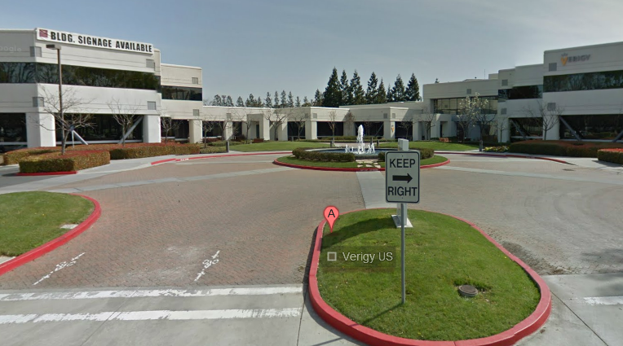
facilities
10100 N Tantau Ave Cupertino, CA 95014
3000 sq ft
$2.25 per square foot per month

Slide 28

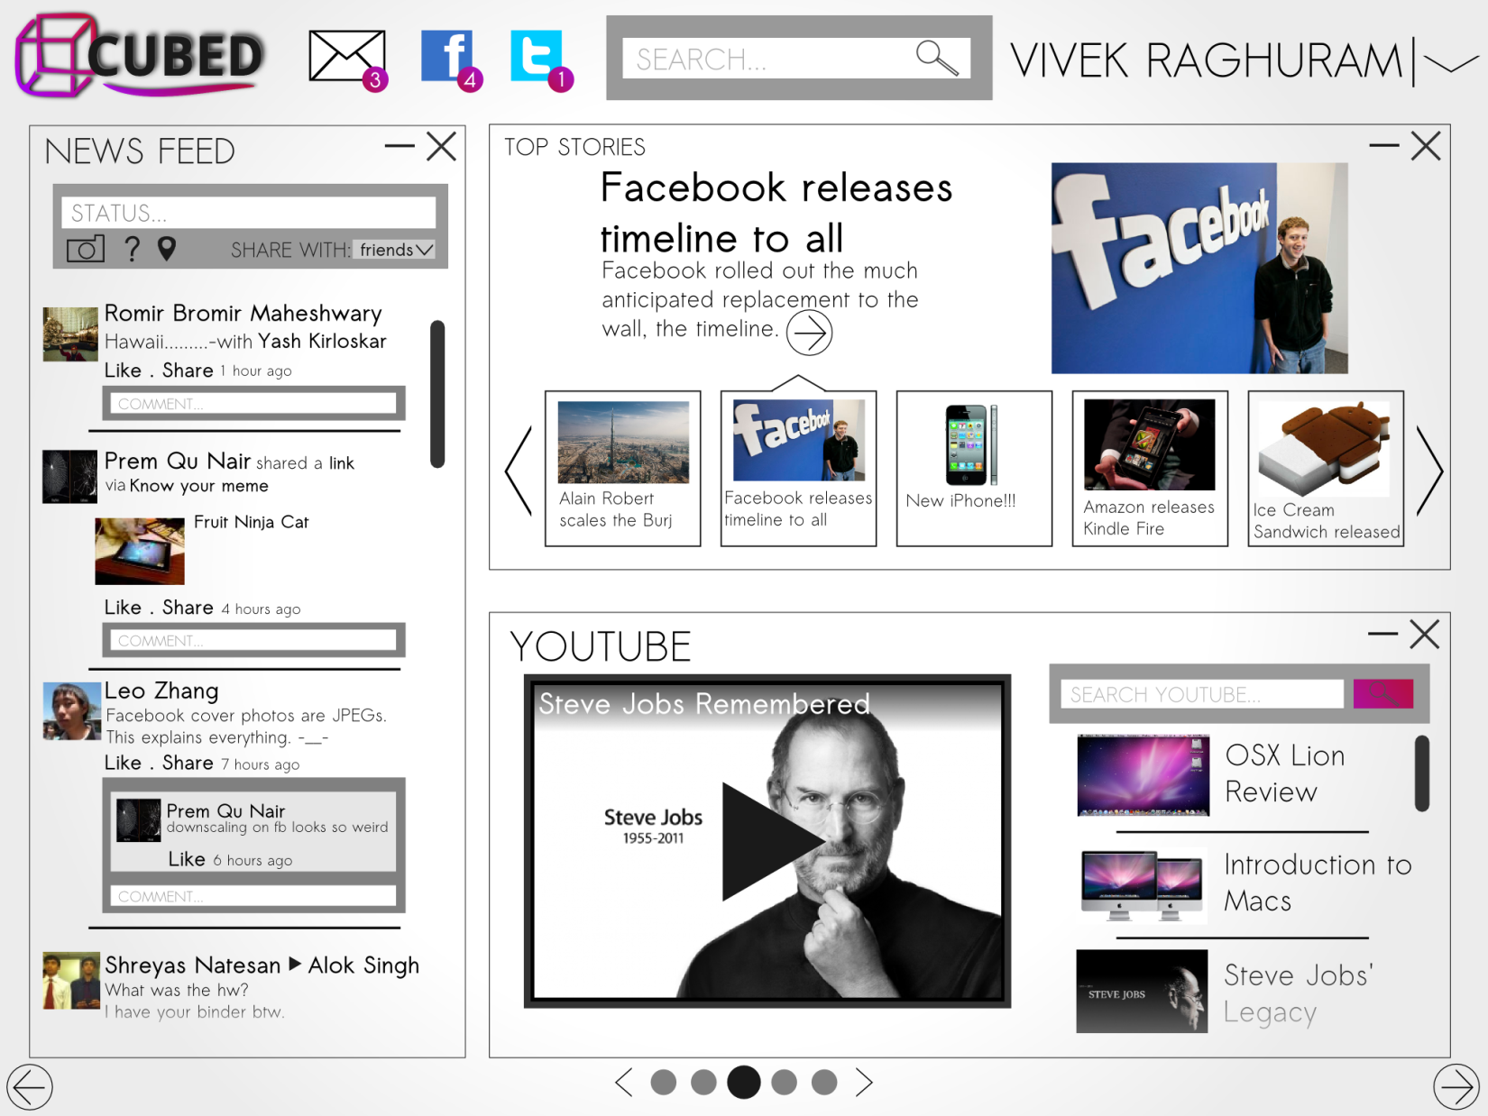

Slide 29
